Slide 1





VP Interconnection Systems
VP Operations Aerostructures
Architecture & Design
Interconnection & Avionics
Architecture & Design Aerostructures
Stress
Aerostruct. & Interco.
Methods & Tools
Airworthiness & Safety
Operations Engineering
Interconnection
Operations Engineering Aérostructures

Slide 2


Engineering Organization
VP Interconnection Systems
VP Operations Aerostructures
Administration & accounting
Engineering Quality
Architecture & Design
Interconnection & Avionics
Architecture & Design Aerostructures
Stress
Aerostruct. & Interco.
Methods & Tools
Airworthiness & Safety
Operations Engineering
Interconnection
Operations Engineering Aérostructures

Slide 3

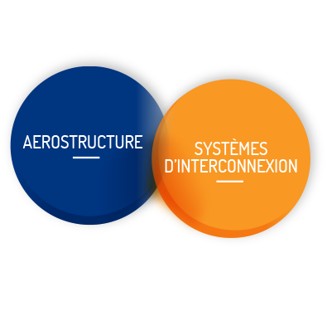

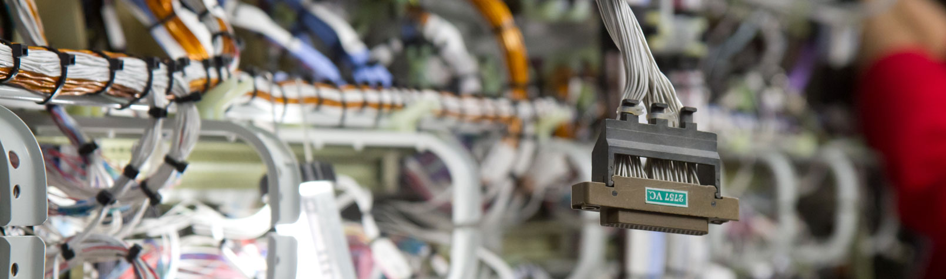
LATECOERE Group Overview
Aerostructures
Interconnection Systems
Design and build
Activity
Independent world leader in aircraft doors
Top 6 in Europe for fuselage sections
World leader in Avionics Racks
#2 worldwide for electrical harnesses
2016 revenue
and % of total revenue
€423 million
€232 million
56%
58.6%
Notes:
Voir les chiffres de 2015
Voir une slide qui existe déjà

Slide 4
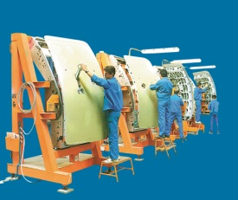
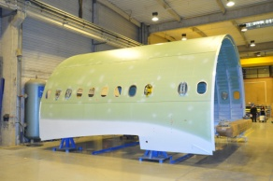

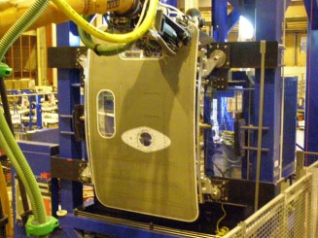
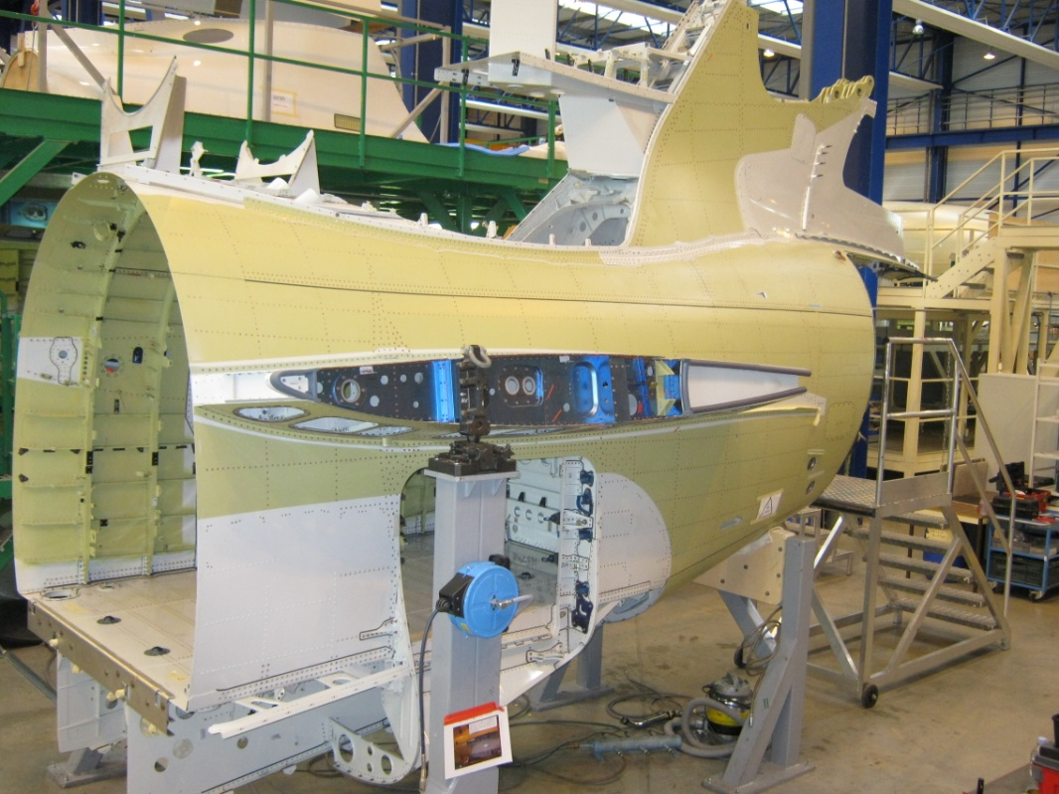


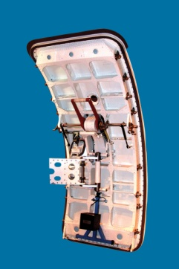

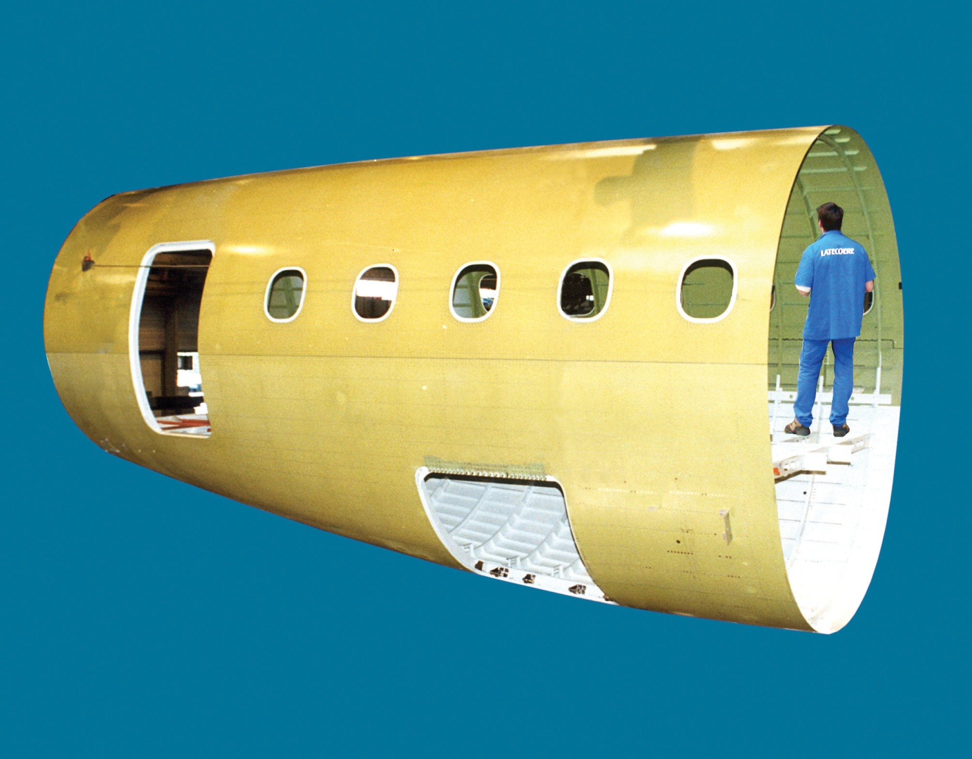
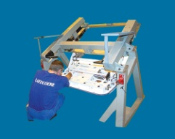
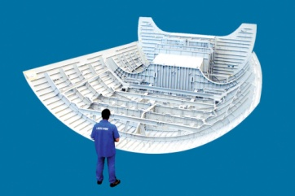
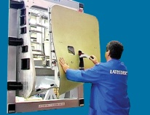
Aerostructures: strong positions
Doors
Fuselages
A320-NEO PAX doors
A330 Fuselage Upper Shell
A380 PAX doors (up. deck)
B787 PAX doors
Falcon 7X – 8X Rear Fuselage Section
B777F Cargo doors
Rafale T56 Section
E-Jets- E1
PAX and Cargo
E-Jets - E1 170-190 Centre Fuselage III
E-Jets - E2
PAX, OWE & Cargo
E-Jets - E1 170-190 Centre Fuselage I
CRJ 700/900 Baggage Bay door
A380 Lower Nose Section
Falcon 7X – 8X Baggage Bay doors
A350 Nose Fairing
Notes:
4

